Slide 1


Slide 2
Rockbuster Stealth LLC is a movie rental company that used to have stores around the world. Facing stiff competition from streaming services such as Netflix and Amazon Prime, the Rockbuster Stealth management team is planning to use its existing movie licenses to launch an online video rental service in order to stay competitive.
● Which movies contributed the most/least to revenue gain?
● What was the average rental duration for all videos?
● Which countries are Rockbuster customers based in?
● Where are customers with a high lifetime value based?
● Do sales figures vary between geographic regions?

Slide 3
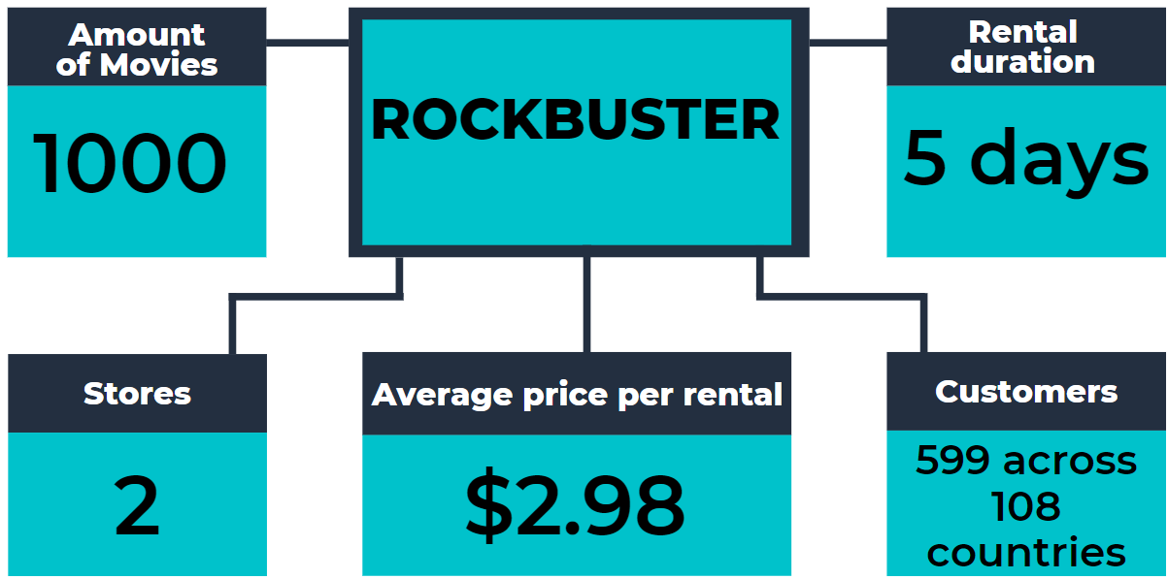

Slide 4

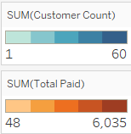
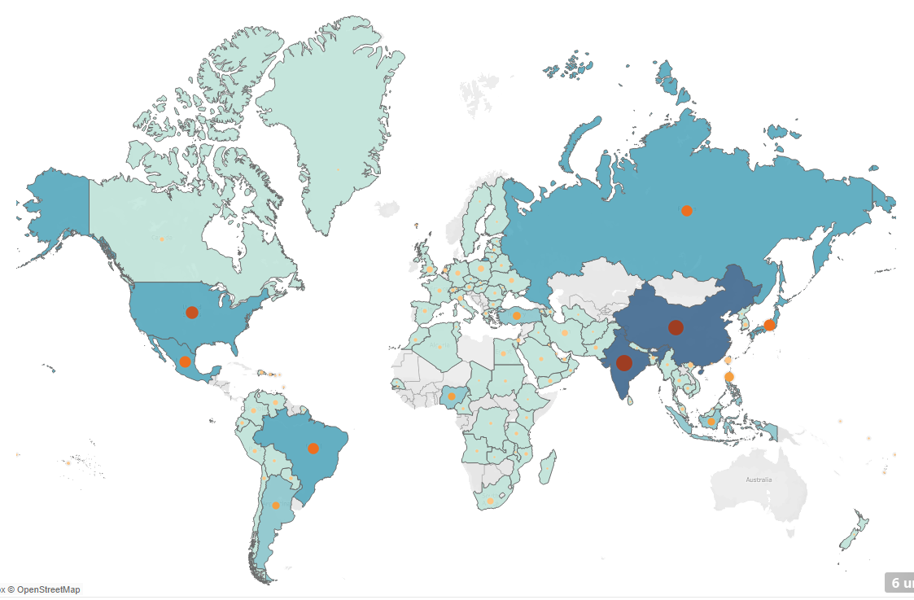
Top 10 Countries by Revenue
India
China
United States
Japan
Mexico
Brazil
Russian Federation
Philippines
Turkey
Indonesia
Source

Slide 5

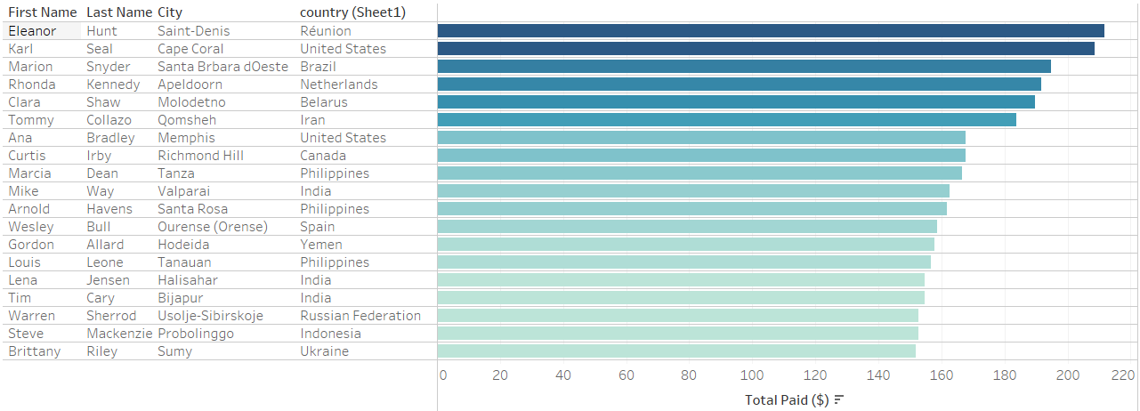
Out of our top 20 customers, we have 8 in 3 countries:
2 in the US
3 in the Philippines
3 in India
Source

Slide 6


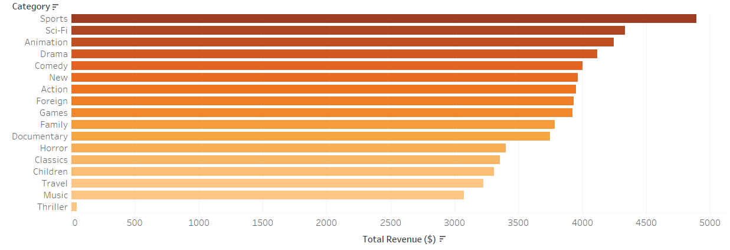
Source

Slide 7
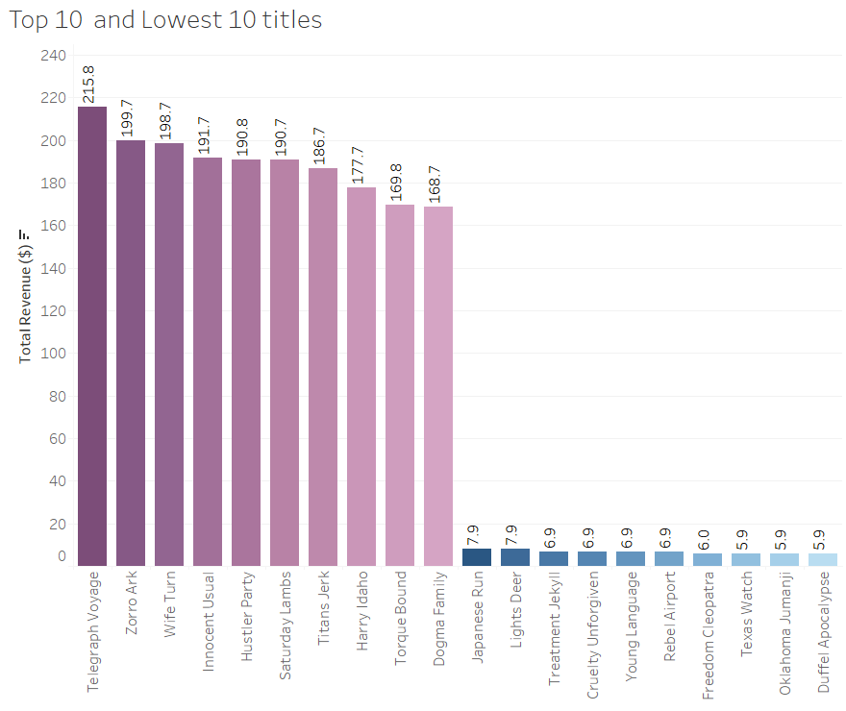
Source

Slide 8

Focus on Asia and North America – 3 of our top 5 countries are located in Asia, and 2 in North America.
If we are only focusing on our initial streaming launch in the above territories, we will not lose the income
stream from most of our top 20 customers, as they are in other territories.
As the top category is Sport – look into partnerships with other entities to bring sport to streaming. Sport
is Rockbusters biggest earner, so we should expand on that.
Invest in more product within the genres Sci-Fi, Animation, Drama and Comedy, as they are in our top 5 earners.
Although there is no solid pattern with the Top 10 titles, we should look into signing a deal with the
directors or producers of these movies to create original content for the streaming service on launch.
The average rental price of 1 video is $2.98. If we double to price for streaming we should aim to increase our
customer base by 1705% - from 599 customers to at least 10218.

